Slide 1





Using Computational Methods to Analyze Educational Data
Camilo Vieira, PhD Alejandra J. Magana , PhD
Mireille (Mimi) Boutin, PhD
49th Annual Frontiers in Education (FIE) Conference
October 19th, 2019
Informática Educativa
This work has been partially supported by the NSF grant awards EEC#1826099.

Slide 2

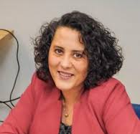

About Us
Dr. Camilo Vieira
Assistant Professor at Universida del Norte (Colombia)
Computational Science and Engineering Education
Computing education
Learning analytics for engineering education.
Prof. Alejandra J. Magana
Professor of the Computer and Information Technology Department at Purdue
Characterizing modeling and simulation practices in science and engineering
Cyberlearning in STEM
Prof. Mireille “Mimi” Boutin
Associate professor in the School of Electrical and Computer Engineering at Purdue
“Learning by Teaching”
www.projectrhea.org
Machine learning and applied mathematics

Slide 3
The plan for today
Introducing the studies (45 minutes)
Conforming groups (5 minutes)
Wrap up (5 minutes)
R Programming (25 minutes)

Slide 4
“For every professional software developer in the world, there are nine more people programming as part of their jobs who aren't professional software developers” Guzdial, 2015.

Slide 5
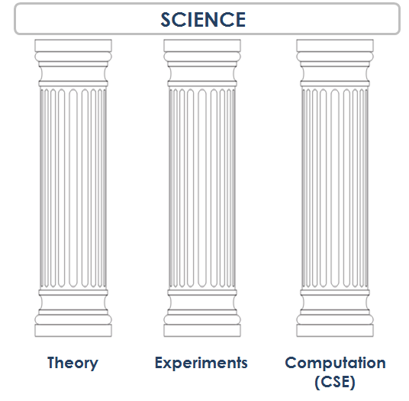
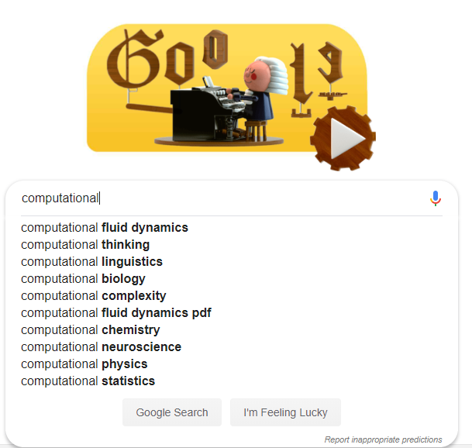

Slide 6


A Data Analysis Process
Raw Data
Assign Categories / Codes
HD Data
Find Themes
Groups
Validate and Characterize
Based on numbers, supports
Exploration
Categorization
Grouping
Validation
A Pattern Recognition Process
Raw Data
Get counts
HD Data
Reduce dimensionality
Feature Vectors
Find Groups
Groups
Validate and Characterize

Slide 7
What is its meaning?
Numbers
What format? (e.g., binary, integer)
Exploration
Categorization
Categorization
Grouping

Slide 8

Computers DON’T do all the work

Slide 9

Literature Review
Exploration
Categorization
Grouping
Validation
Summarize findings of a literature review using visualizations

Slide 10
VISUAL LEARNING ANALYTICS – A Lit. Review
Goal:
(1) Identify the main uses of visualizations in educational research
(2) Identify gaps and future opportunities for conducting research and creating visualization tools that can help advance the field of visual learning analytics.
Hypothesis: InfoVis experts and Education experts working separately.
Vieira, C., Parsons, P., & Byrd, V. (2018). Visual learning analytics of educational data: A systematic literature review and research agenda. Computers & Education, 122, 119-135.

Slide 11
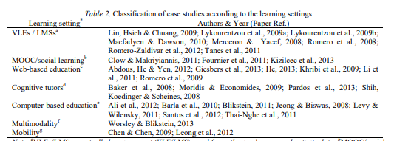
Literature Review
Traditional Approach:

Slide 12
VISUAL LEARNING ANALYTICS
Criteria | 1-2 | … | 9-10
Connection with Visualization Background (CVB) | The paper does not mention any visualization theory, guidelines, or principles |  | The paper critically analyzes the relevant literature in visualization and makes an informed decision for the proposed tool and discusses the findings using existing literature in visualization
Connection with Educational Theory (CET) | The paper does not mention any educational theory |  | The paper engages in critical analysis of educational theory and informs the design of the visualization using an educational theory and discusses the results of the work under the lens of this theory
Sophistication of Visualization (SoV) | None of these elements is present: Multiple visualizations; Connected visualizations; Visualizing data at multiple levels; Interactive Visualization Novel Visualization |  | All these elements are present: Multiple visualizations; Connected visualizations; Visualizing data at multiple levels; Interactive Visualization Novel Visualization

Slide 13
VISUAL LEARNING ANALYTICS
Criteria | 1-2 | … | 9-10
Connection with Visualization Background (CVB) | The paper does not mention any visualization theory, guidelines, or principles |  | The paper critically analyzes the relevant literature in visualization and makes an informed decision for the proposed tool and discusses the findings using existing literature in visualization
Connection with Educational Theory (CET) | The paper does not mention any educational theory |  | The paper engages in critical analysis of educational theory and informs the design of the visualization using an educational theory and discusses the results of the work under the lens of this theory
Sophistication of Visualization (SoV) | None of these elements is present: Multiple visualizations; Connected visualizations; Visualizing data at multiple levels; Interactive Visualization Novel Visualization |  | All these elements are present: Multiple visualizations; Connected visualizations; Visualizing data at multiple levels; Interactive Visualization Novel Visualization

Slide 14
VISUAL LEARNING ANALYTICS
Criteria | 1-2 | … | 9-10
Connection with Visualization Background (CVB) | The paper does not mention any visualization theory, guidelines, or principles |  | The paper critically analyzes the relevant literature in visualization and makes an informed decision for the proposed tool and discusses the findings using existing literature in visualization
Connection with Educational Theory (CET) | The paper does not mention any educational theory |  | The paper engages in critical analysis of educational theory and informs the design of the visualization using an educational theory and discusses the results of the work under the lens of this theory
Sophistication of Visualization (SoV) | None of these elements is present: Multiple visualizations; Connected visualizations; Visualizing data at multiple levels; Interactive Visualization Novel Visualization |  | All these elements are present: Multiple visualizations; Connected visualizations; Visualizing data at multiple levels; Interactive Visualization Novel Visualization

Slide 15
https://infovisreview.github.io/VLAVisualizations/

Slide 16
Classroom Observation
Exploration
Categorization
Grouping
Validation
Characterize changes or improvements in teaching practices via classroom observations

Slide 17
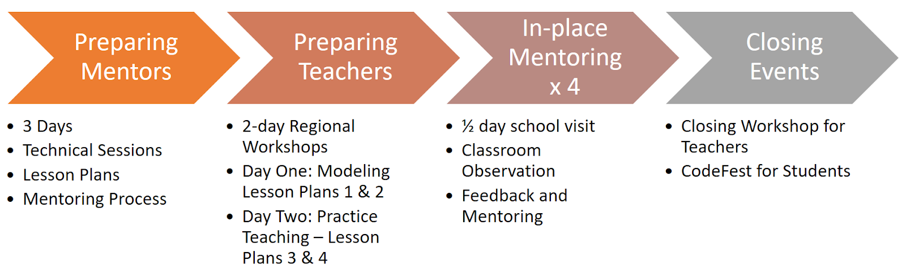
Coding for Kids
Goal: Identifying changes in teaching practices from longitudinal data

Slide 18
Rubric for Classroom Observation
 | Low | Medium | High
Norms and Procedures | There are no clear norms and procedures. The instructor has to ask for silence often, and repeats frequently how to get the materials. | There are some norms but students do not always follow them, and the teacher does noting to promote it. | There are clear norms and procedures, which students follow most of the time.
Effective Teaching Time | Less than 50% of the time is devoted to teaching and learning activities. | Between 50% and 70% of the time is dedicated to teaching and learning activities. | More than 70% of the time is devoted to teaching and learning activities

Slide 19
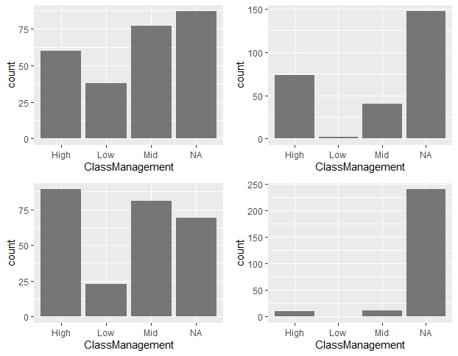
Distribution and Longitudinal Data
Traditional Approach:

Slide 20
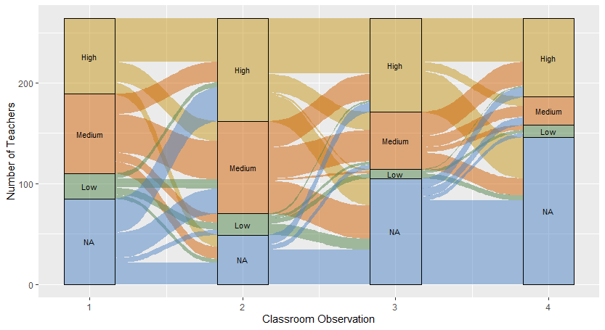
Progression on Effective Teaching Time

Slide 21
Progression on Effective Teaching Time

Slide 22
Progression on Effective Teaching Time

Slide 23
Progression on Effective Teaching Time

Slide 24
Identifying whether these groups are statistically significant
Can we use parametric or non-parametric tests?
Permutation test(Ernst, 2004, Huo, Heyvaert, Van Den Noortgate, and Onghena, 2014):
Null hypothesis: the groups are identically distributed
Alternative hypothesis: at least one of the groups is not identically distributed to the rest of them
Assumption: independence among observations
Vieira, C. Magana, A. J., Boutin, M. (2017) Add-on Preferential Groups (APG): Analyzing student preferences of teaching methods. Manuscript submitted for publication.

Slide 25
Significant Groups?
Permutation test:
12
23
22
32
8
15
25
24
13
17
18
15
Mean = 14.67
Mean = 22.6
Diff = 14.67 - 22.6 = -7.93

Slide 26
Significant Groups?
Permutation test:
17
23
13
32
Previous Differences
-7.93
15
24
25
15
22
12
18
8
Mean = 18.83
Mean = 18.5
Diff = 18.83 – 18.5 = 0.33

Slide 27
Significant Groups?
Permutation test:
25
24
22
32
Previous Differences
-7.93
0.33
-1.33
....
8
15
17
12
13
23
18
15
Mean = 18
Mean = 19.3
Diff = 18-19.3= -1.3

Slide 28
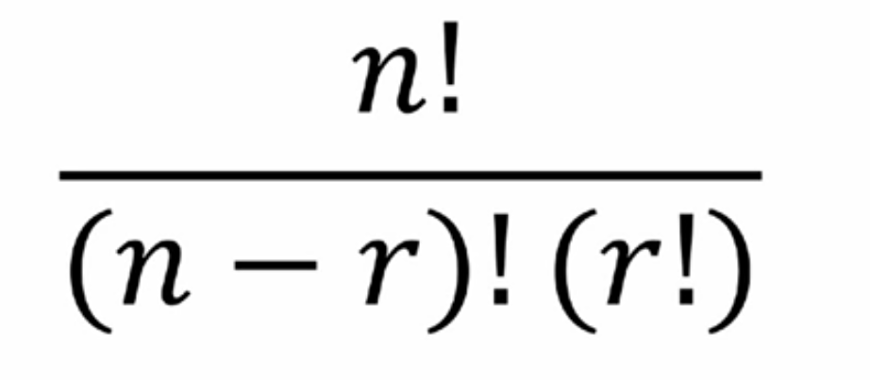
Significant Groups?
Permutation test:
Number of permutations:
n is the sample size
r is the number of observations per group.
With n=30 and r=15, there are: 155117520 permutations!
Previous Differences
-7.93
0.33
-1.33
....

Slide 29
Think-Aloud Data
Exploration
Categorization
Grouping
Validation
Identify patterns of types of knowledge students used in different stages of the problema solving process

Slide 30
Analysis of think-aloud data
Context:
Programming course for Materials Science and Engineering
17 students were invited to participate in a think-aloud activity doing computational modeling
Goal: Characterize students’ modeling process and usage of the different types of knowledge

Slide 31
An adaptation of the modeling process (Shiflet & Shiflet, 2014).
Analyze
Solve
Verify
Maintain

Slide 32
Types of Knowledge (ToK)
Type of knowledge (Shavelson, Ruiz-Primo, Li, & Ayala, 2003)
Declarative (knowing that)
Procedural (knowing how)
Schematic (knowing why)
Strategic (knowing when, where, how)

Slide 33
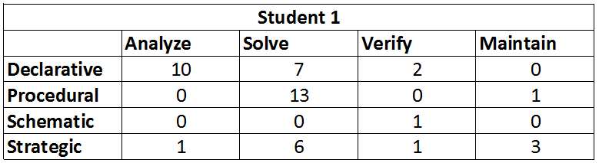
Sample counts: ToK x Modeling step by Student

Slide 34
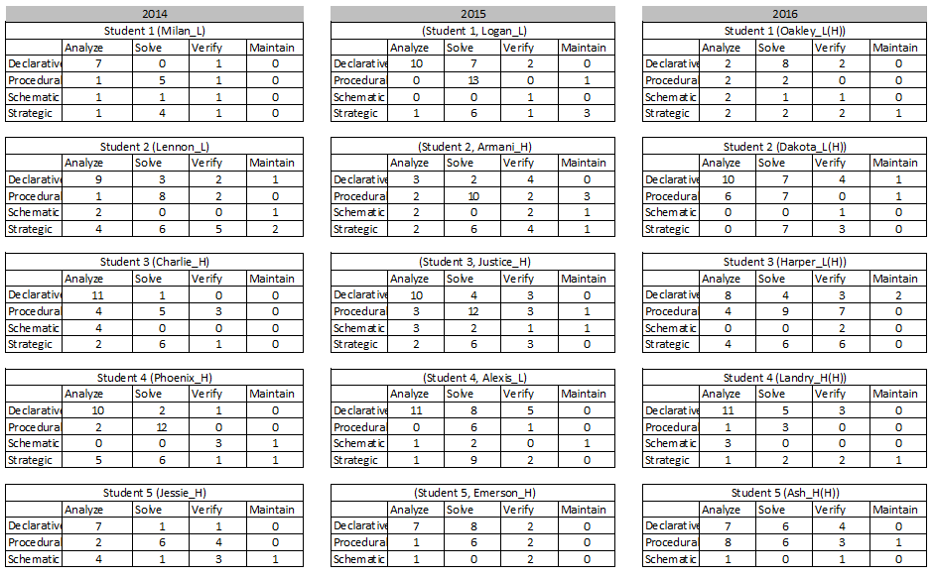
Sample counts: ToK x Modeling step by Student
Traditional Approach:

Slide 35
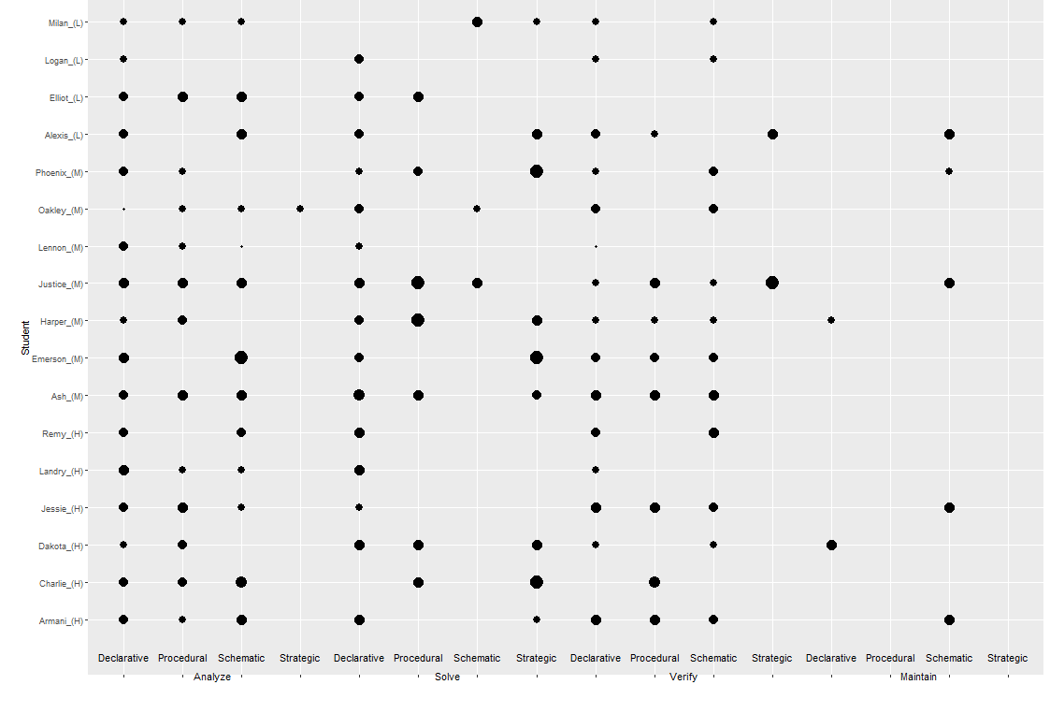
Visualizing
Student
Declarative
Procedural
Schematic
Strategic
D
P
S
D
P
S
S
D
P
S
S
D
P
S
S
D
P
S
S
S
Analyze Solve Verify Maintain

Slide 36
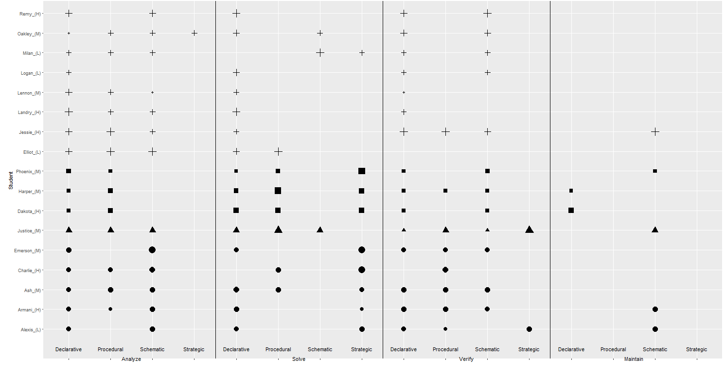
Visualizing – Clustered by counts (K-means)
Group 1
Group 2
Group 3
Group 4
Declarative
Procedural
Schematic
Strategic
D
P
S
D
P
S
S
D
P
S
S
D
P
S
S
D
P
S
S
Analyze Solve Verify Maintain
S

Slide 37
Artifact Analysis
Exploration
Categorization
Grouping
Validation
Identify Learner Profiles of habits of mind via document analysis

Slide 38
Analysis of think-aloud data
Habits of Mind:
A person's outlook on knowledge and learning and ways of thinking and acting.
Mathematical and logical skills that are essential tools for both formal and informal learning and for a lifetime of participation in society as a whole.
Goal: Identify students’ different ways of thinking when explaining phenomena in the domain of signal processing

Slide 39
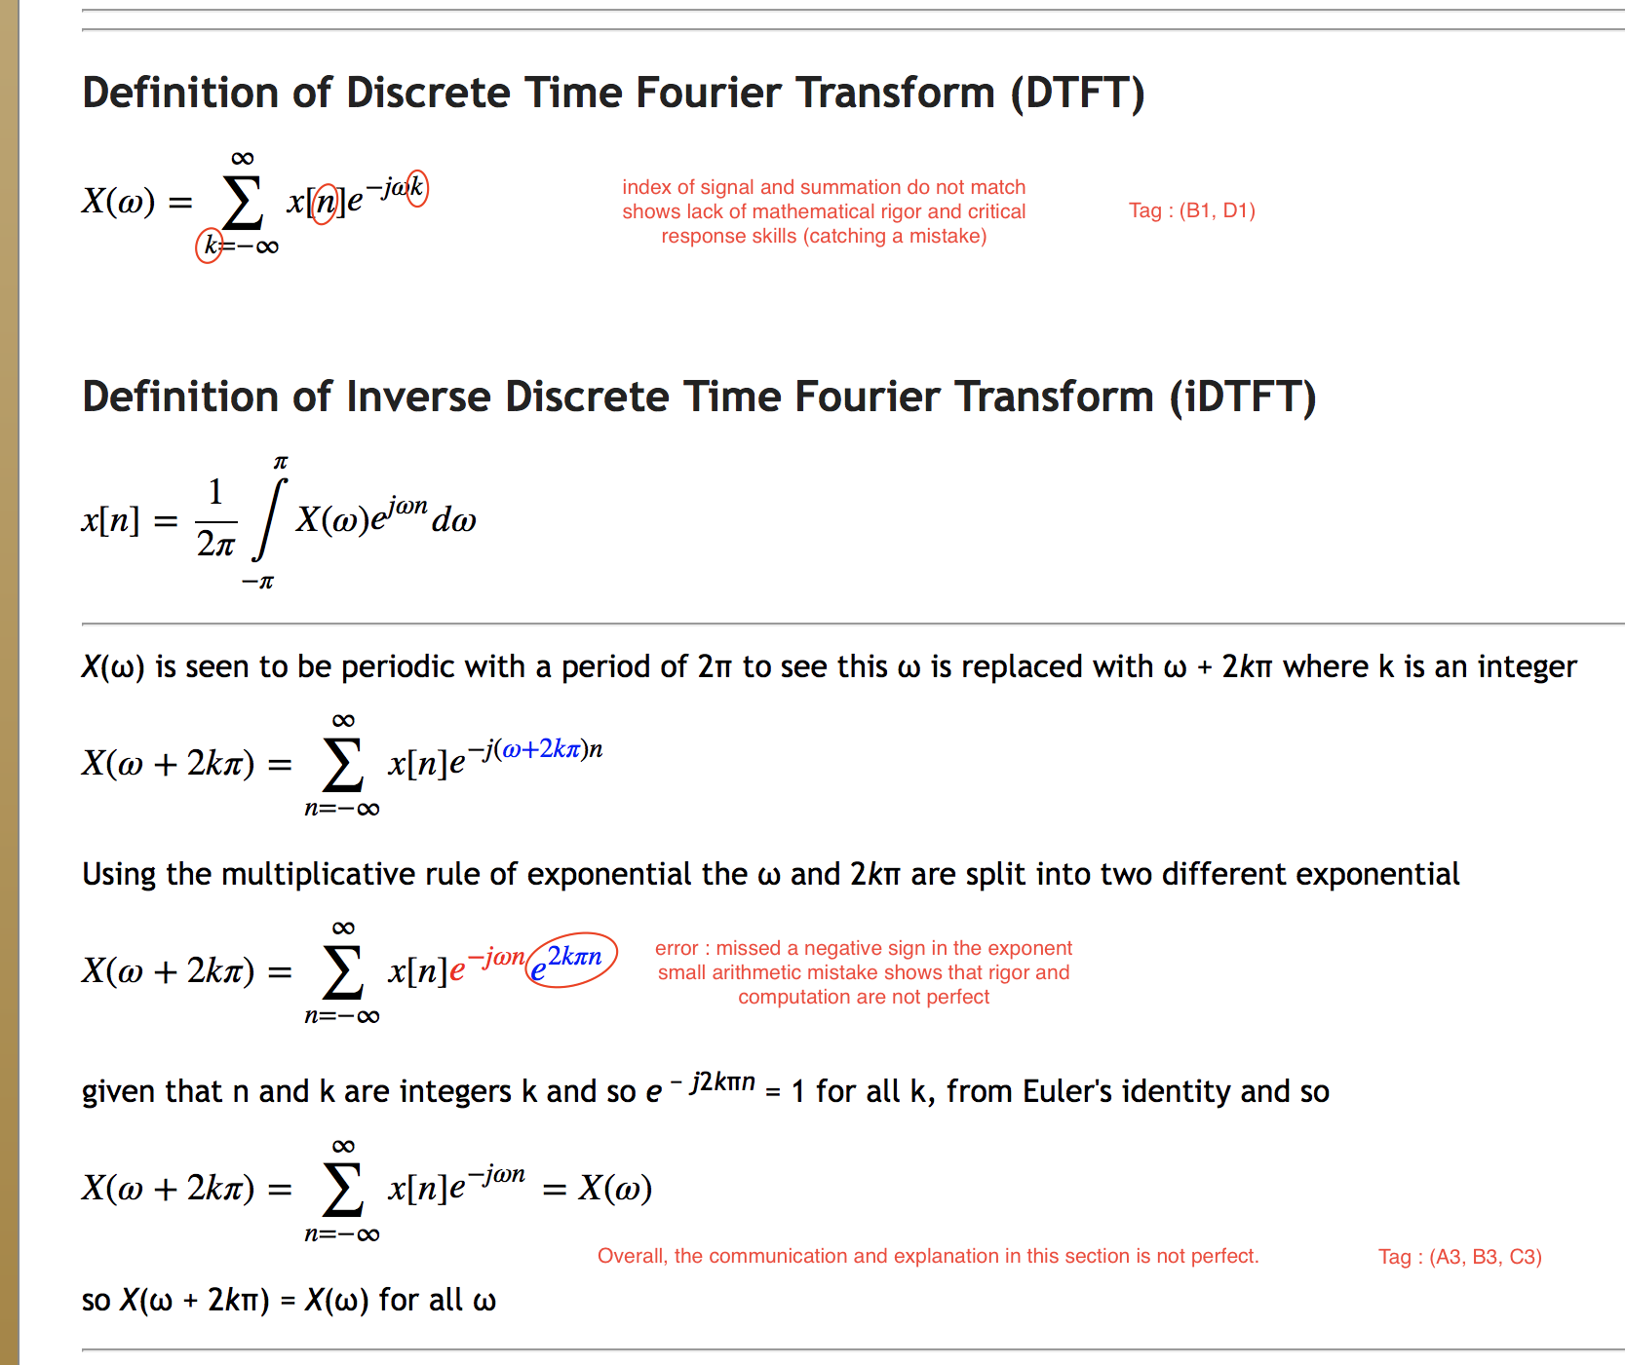
Elicitation of Student Performance

Slide 40
Qualitative Analysis – Traditional approach
“Values and attitudes” was operationalized as students’ critical views of their own work and that of their peers:
“I think specific outline is very helpful and make easy to follow the formula and graphs. Formulas and graphs are very clear to understand.”
“I think an important aspect that you did not include in your final answer is that the DTFT of a DT signal must be periodic. Your answer must be "rep-ed" to denote it's periodicity. Otherwise your answer is only correct for o<=w<=2pi. The DTFT of x[n] is rep₂π(2πδ(ω-ω₀)) Overall color coating was very helpful, and the slecture was concise and clear.”

Slide 41
Quantification of Qualitative Data
Description |  | Level of Performance
Element | Definition | Below Basic 1 | Basic 2 | Proficient 3 | Advanced 4
Computation and Estimation | Ability to choose an appropriate computation method and carry out the mathematical procedure accurately | Student selected an incorrect method and the solution was completely off. | Student selected a correct method but the solution was incorrect. | Student selected an appropriate method and the solution was correct. However, the student did not provide a justification for the method based on the circumstances, or the justification was inadequate. | Student selected an appropriate method, the student provided a correct justification for the selection of the method based on the circumstances and the solution was correct.
Mathematical Rigor | Ability to handle mathematical rigor and remember details of a definition | Student was not at all rigorous in the involved mathematics. | Student displayed some rigor but there were major errors. | Student was very rigorous but made small errors. | Student was very rigorous and made no errors.
Communication Skills | Ability to communicate effectively, explain background and present a good meaningful flow of ideas | Student presented an unclear and unjustified procedure. | Student presented a somewhat clear procedure but it was unjustified. | Student presented a clear procedure with a reasonable justification. | Student presented a clear procedure with a detailed justification based on the theory or principles.
Critical Response Skills | Ability to detect the symptoms of doubtful solutions, assertions and arguments in one’s own work and in peers. | Student was unable to identify incorrect procedures and provided no evidence of procedures for validation of their solution. | Student was able to identify incorrect procedures but was unable to correct them. The student provided no evidence of procedures for validation of their solution. | Student was able to identify incorrect procedures and corrected them properly. However, the student provided no evidence of procedures for validation of their solution. | Student was able to identify incorrect procedures and corrected them properly or did not demonstrate any incorrect procedures. In addition, the student demonstrated evidence of applying procedures for validation of their solution.
Values and Attitudes | Student’s attitude towards their own ability and those of their peers. | Student made negative comments about other’s work or was indifferent to it. | Student made generic comments that do not provide any insight or critique. | Student made good comments providing insight and a somewhat reasonable critique. | Student made excellent comments, correcting mistakes and providing insightful critique.

Slide 42
Interpretation
Model sequence of scores (tag) of each student as random process
For simplicity, assume successive scores are independent
Estimate probability of each score occurring
P_{ij} = Prob(element_{i}, level_{j}), i=1,2,3,4,5, j=1,2,3,4
Count the total number of scores: N
Parameters of random process used as features
Each student represented by vector in R²¹
(P₁₁,P₁₂,P₁₃,…, P₄₅, N)

Slide 43
Half of students used as “Observation Data”
Remaining half used later as “Validation data”
Cluster features of students in Observation Data using random approach called N-TARP
Results in many different binary clusterings
Each binary clustering gives a label for each student
1 if student belongs to first cluster
2 if student belongs to second cluster
Concatenate the cluster labels and add grade to obtain a profile for each student
E.g., student 1 represented by (1,1,2,1,1,1,2,2,2,2,1,1,1,1,1, B)

Slide 44
Use Validation Data to corroborate each binary clustering found
Half students in validation data
Used permutation test to check statistical significance of difference between clusters
Permutation test appropriate because data is small
Analyze differences in grades between students in different clusters
Discuss the findings

Slide 45
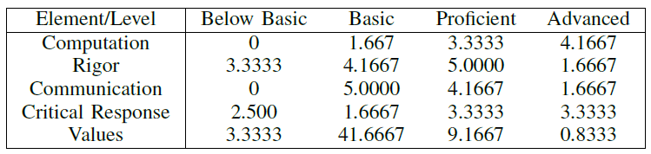
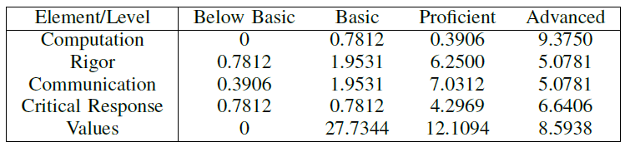
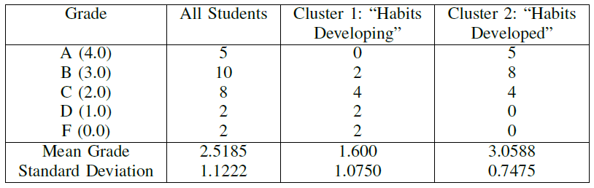
Cluster 1:
Habits developing
Cluster 2:
Habits developed

Slide 46
Survey Data
Exploration
Categorization
Grouping
Validation
Visualize and group categorical data of students’ preferences

Slide 47
Student Preferences
Indicate your preferences about the following programs
Economy, Management, Law, Biology, Chemistry, Physics, Math, CS, Engineering
[Among my preferred ones; Seems interesting; Not very interested; I’d avoid it;
I don’t know anything about it ]
Goal: Identify student perceptions and preferences about different undergraduate programs

Slide 48
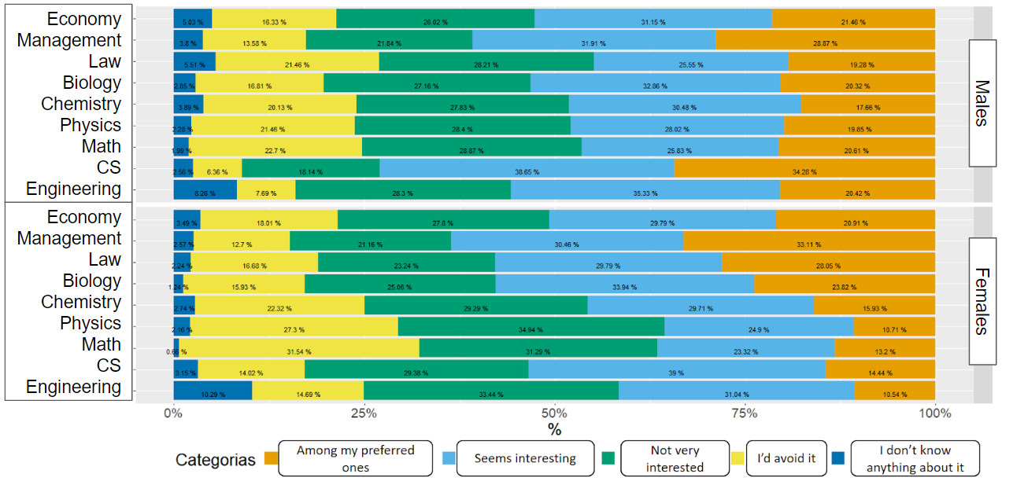
Student Preferences of Undergraduate Programs

Slide 49
Multiple Correspondence Analysis + Hierarchical Clustering + Chi-Square
Those who avoid everything (2574, 25.4%)
Girls > Boys
Those who don’t know any program (435, 4.3%)
Girls < Boys
Those interested in everything (6035, 59.5%)
Girls <
Those who choose not to answer (1101, 10.9%)
Girls < Boys
Notes:
El objetivo principal de este método es detectar y describir estructuras llamadas componentes o correspondencias entre variables categóricas en un conjunto de datos dado

Slide 50
Open-Ended Responses
Exploration
Categorization
Grouping
Validation
Semi-automatic categorization of open-ended responses

Slide 51
Open-Ended Responses
Thermal and Transport Science Concept Inventory
Multiple choice assessment instrument that assesses the topics of “diﬀusion”, “heat transfer”, and “microﬂuidics”
For each of the TTCI multiple choice questions, an open-ended question prompted students to explain their rationale for choosing a particular response item.
Goal: Identifying student conceptual change from their open-ended responses

Slide 52
Traditional Approach
Thematic Analysis: Identifying categories and codes to identify patterns (themes) from the data
Content Analysis: Counting frequency of words or phrases
Banks, G. C., Woznyj, H. M., Wesslen, R. S., & Ross, R. L. (2018). A review of best practice recommendations for text analysis in R (and a user-friendly app). Journal of Business and Psychology, 33(4), 445-459.

Slide 53
Data Analysis Process

Slide 54
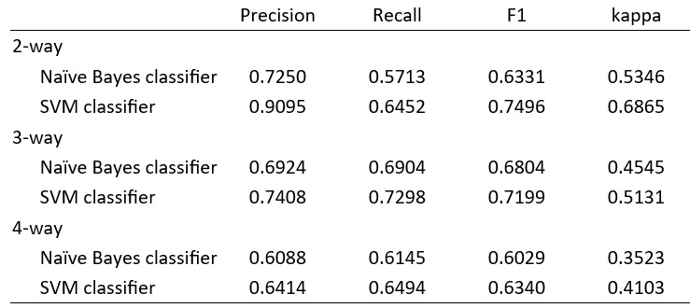
Results

Slide 55
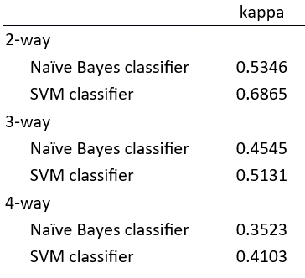
Results

Slide 56
Let’s try it out

Slide 57
Let’s try it out
R Programming - Handout
We brought 6 computers - Create groups and distribute among the computers
Check out the handout
If you don’t have any experience with R, start by: IntroductionToR.R
Plots: IntroToPLots.R
Clustering: ClusteringPlusPlots.R

Slide 58
Overall Conclusions and Next Steps
Computation can be used to explore complex educational data, as well as identify, characterize and validate groups
Different visualization, clustering, and validation techniques should be used depending on the data
The interpretation and connection with theory is responsibility of the researcher
R code available at www.github.com/cvieiram
How can you use this in your own research?

Slide 59





Acknowledgements
Prof. Alejandra J. Magana
Prof. Mireille (Mimi) Boutin
Dr. Camilo Vieira
Hayden Fennell
Tarun Yellamraju
Natalia Hernandez
Informática Educativa
This work has been partially supported by the NSF grant awards EEC#1826099

Slide 60
About Us
Dr. Camilo Vieira
Assistant Professor at Universida del Norte (Colombia)
cvieira@uninorte.edu.co
Prof. Alejandra J. Magana
Professor of the Computer and Information Technology Department at Purdue
admagana@purdue.edu
Prof. Mireille “Mimi” Boutin
Associate professor in the School of Electrical and Computer Engineering at Purdue
mboutin@purdue.edu

Slide 61
Thank you!
Questions?
Camilo Vieira, PhD
cvieira@uninorte.edu.co / @cvieiram Prof. Alejandra J. Magana admagana@purdue.edu Prof. Mimi Boutin mboutin@purdue.edu

